Slide 1
Python : Visualization
Pandas Visualizaiton
Matplotlib
Seaborn
ggplot
Statistical graphs

Slide 2
Lesson Objectives
Learn about Python Visualization
Many different packages and options.

Slide 3
Lesson Objectives
Learn about Python visualization
Introduction to different packages and available options
pandas
matplotlib
seaborn
ggplot
Comparison on a few statistical graphs

Slide 4
Pandas Visualization
➔ Pandas Visualization
Matplotlib
Seaborn
ggplot
Statistical graphs

Slide 5
Pandas Visualization
Pandas has built–in visualization.
Basically aliases similar functionality in matplotlib
Good for representing plots of dataframes
Can do things like add labels, etc through matplotlib.pyplot
“pandas” website - https://pandas.pydata.org/pandas-docs/stable/visualization.html

Slide 6
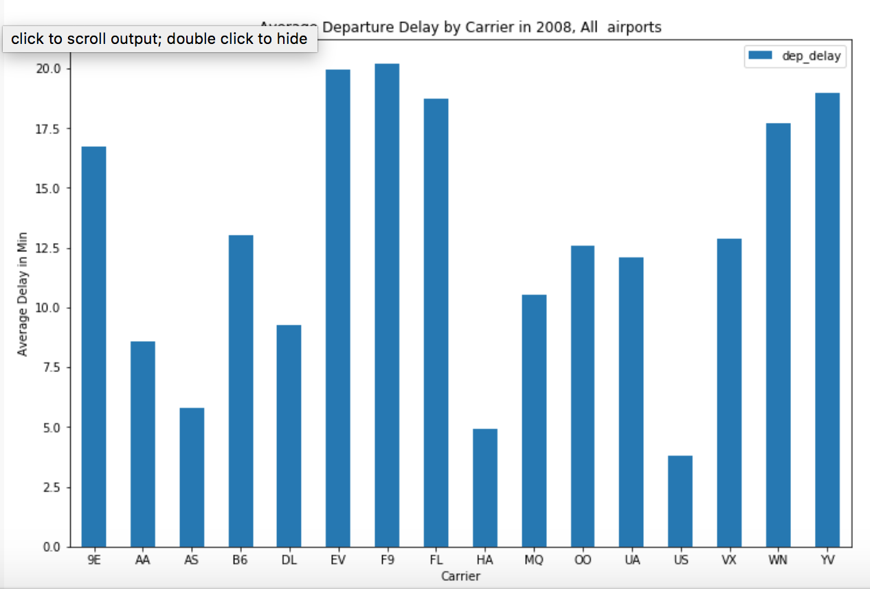
Pandas Bar plot
df.groupby('carrier').mean().plot(kind='bar', figsize =(12,8))
plt.xticks(rotation=0)
plt.xlabel('Carrier’)
plt.ylabel(‘Delay’)
plt.title('Average Arrival Delay')

Slide 7
Pandas visualization
>>> df.groupby('carrier').mean().plot(kind='bar', figsize =(12,8))
>>> plt.xticks(rotation=0)
>>> plt.xlabel('Carrier’)
>>> plt.ylabel(‘Delay’)
>>> plt.title('Average Arrival Delay')

Slide 8
Matplotlib
➔ Matplotlib
Seaborn
ggplot
Statistical graphs

Slide 9
Matplotlib
Matplotlib is python’s native plotting library
Powerful, with lots of options
Not necessarily focused on aesthetics
Import like this:
To show inside jupyter
Saving to file
import matplotlib.pyplot as plt
%matplotlib inline%
plt.savefig(‘test.png’)

Slide 10
Performing and Showing plot
Call plot on the items you want to plot
You can show the plot in a external window:
plt.plot(x, y) # Pass in ndarrays that you want to plot
plt.show()

Slide 11
Matplotlib plots
“matplotlib” is python’s native plotting library
It is powerful, with lots of options, not focused on aesthetics
“matplotlib” website - https://matplotlib.org/
“matplotlib” needs to be imported
Plotting data in “x”, “y”
To show plots
Saving plots to a file
To show plots inside jupyter notebooks without explicit calls
>>> import matplotlib.pyplot as plt
>>> plt.plot(x, y)
>>> plt.show()
>>> plt.savefig(“test.png”)
>>> %matplotlib inline%

Slide 12
Plot labels and options
plt.xlabel : Label on x-axis
plt.ylabel : Label on y-axis
plt.title : Title on plot
plt.grid = true # Start grid

Slide 13
Matplotlib plot options
To set x axis label
plt.xlabel(“<x label>”)
To set y axis label
plt.ylabel(“<y label>”)
To set title on plot
plt.title(“<title>”)
To turn grid on/off plot
plt.grid(<True/False>)

Slide 14
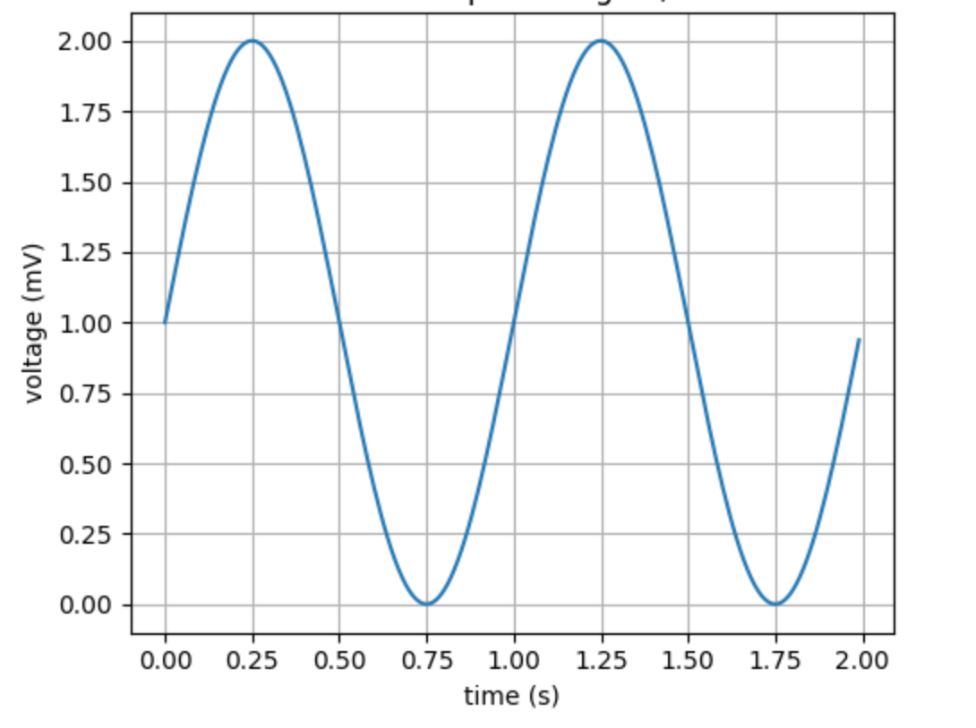
Matplotlib Simple Example
t = np.arange(0.0, 2.0, 0.01)
s = 1 + np.sin(2*np.pi*t)
plt.plot(t, s)
plt.xlabel('time (s)’)
plt.ylabel('voltage (mV)’)
plt.title(‘Sine wave’)
plt.grid(True)
plt.savefig("test.png")

Slide 15
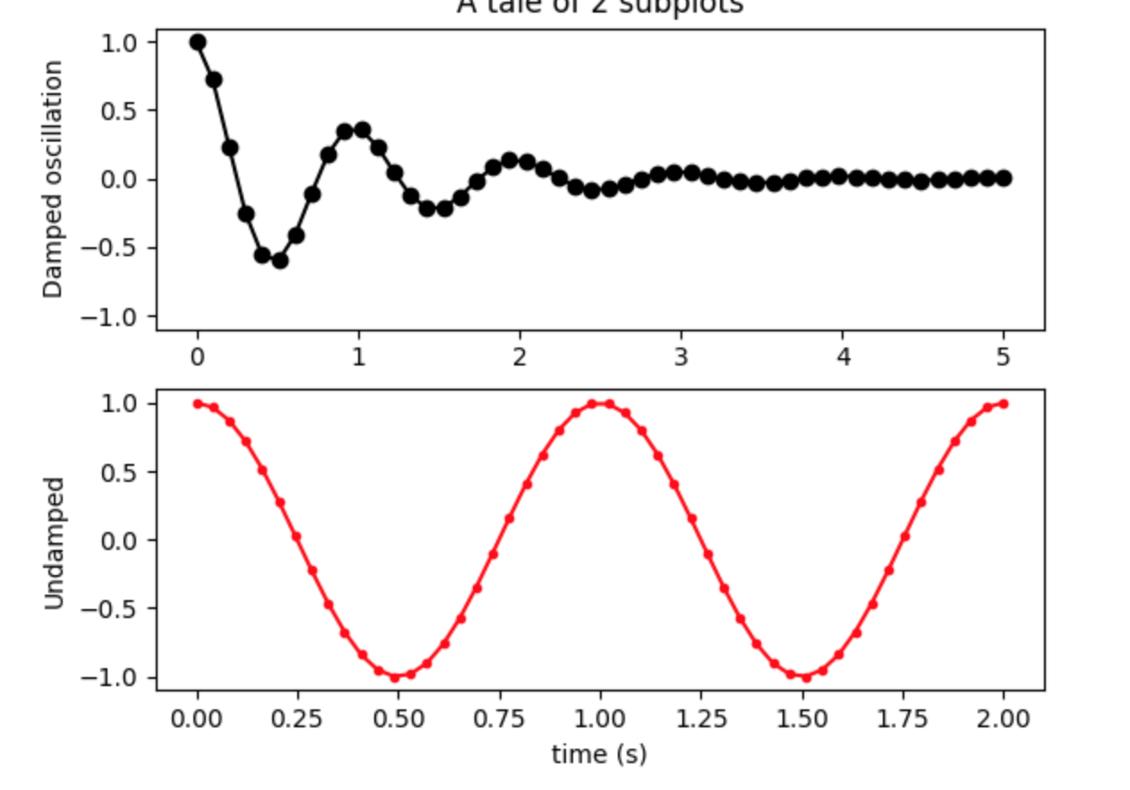
Matplotlib subplots
Matplotlib allows us to create subplots
# Create two subplots sharing y axis
fig, (ax1, ax2) = plt.subplots(2, sharey=True)
ax1.plot(x1, y1, 'ko-')
ax2.plot(x2, y2, 'r.-')
ax2.set(xlabel='time (s)', ylabel='Undamped')

Slide 16
Figure Versus Axes
The figure object is the entire plot
Typically used if we want to save the figure
The axes represent the plots
We can have more than one (subplots)
Here’s how we get one:
More than one (subplots)
import matplotlib.pyplot as plt
fig,ax = plt.subplots() # Just one plot
import matplotlib.pyplot as plt
fig, (ax1,ax2) = plt.subplots(2) #Two subplots

Slide 17
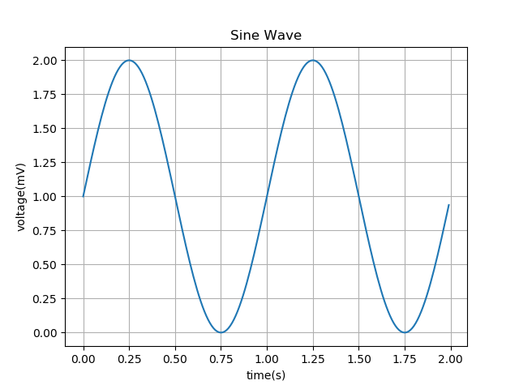
Matplotlib – plot()
Voltage vs Time using plot():
import matplotlib.pyplot as plt
import numpy as np
t = np.arange(0.0, 2.0, 0.01)
s = 1 + np.sin(2*np.pi*t)
plt.plot(t, s)
plt.xlabel('time (s)’)
plt.ylabel('voltage (mV)’)
plt.title(‘Sine wave’)
plt.grid(True)
plt.savefig("test.png")

Slide 18
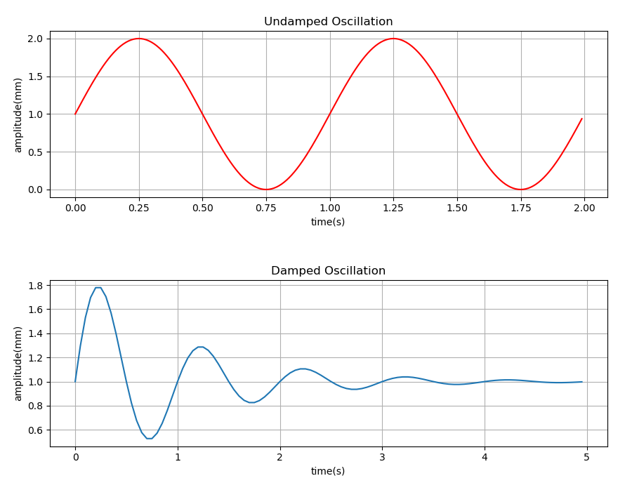
Matplotlib – subplot()
Undamped vs Damped oscillations using subplot():
import matplotlib.pyplot as plt
import numpy as np
x1 = np.arange(0, 2, 0.01)
x2 = np.arange(0, 5, 0.05)
y1 = 1 + np.sin(2 * np.pi * x1)
y2 = 1 + np.multiply(np.exp(-x2), np.sin(2 * np.pi * x2))
plt.figure(num = 1, figsize=(10.24,7.68))
plt.subplots_adjust(wspace = 0.3, hspace = 0.5)
plt.subplot(2,1,1)
plt.plot(x1, y1, color = "r")
plt.xlabel("time(s)")
plt.ylabel("amplitude(mm)")
plt.title("Undamped Oscillation")
plt.grid(True)
plt.subplot(2,1,2)
plt.plot(x2, y2)
plt.xlabel("time(s)")
plt.ylabel("amplitude(mm)")
plt.title("Damped Oscillation")
plt.grid(True)
plt.savefig("matplotlib2.png")
plt.show()

Slide 19
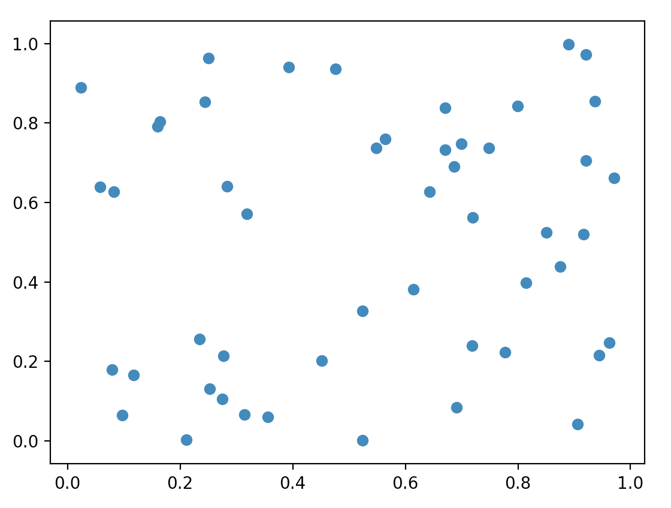
Matplotlib – scatter()
Random numbers using scatter():
import numpy as np
import matplotlib.pyplot as plt
np.random.seed(23238023)
p = 50
x = np.random.rand(p)
y = np.random.rand(p)
# colors = np.random.rand(p)
# area = (30 * np.random.rand(p))**2
plt.scatter(x, y)
# plt.scatter(x, y, s=area, c=colors, alpha=0.5)
plt.show()

Slide 20
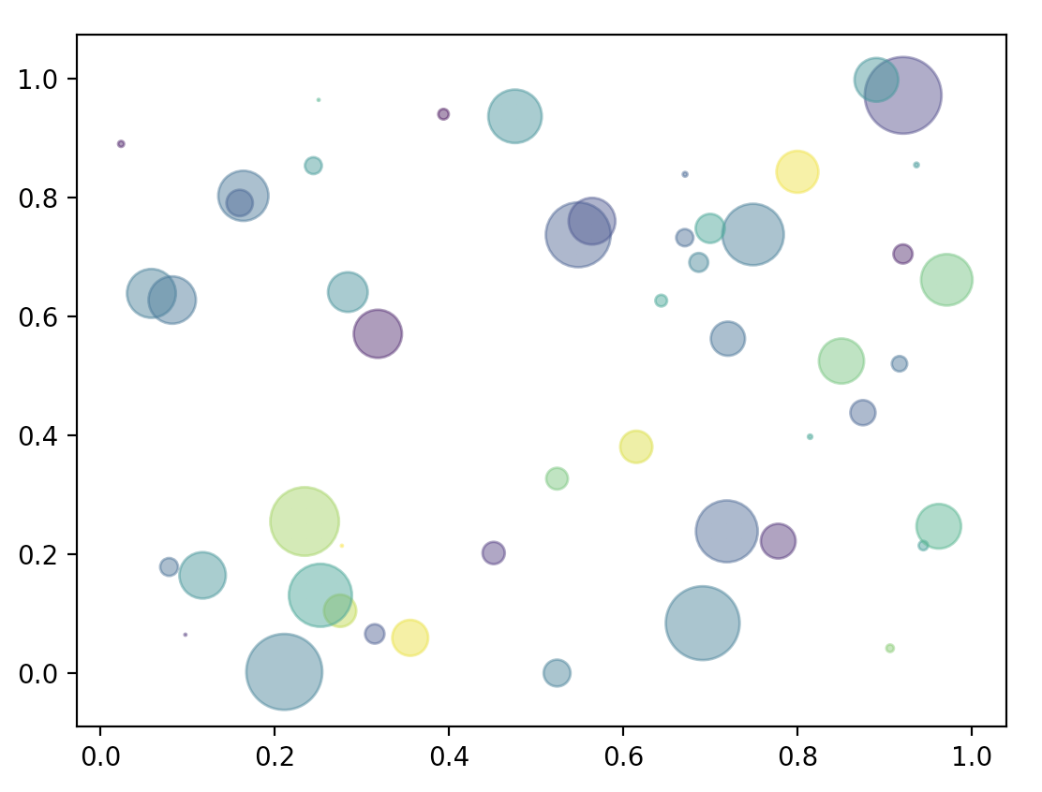
Matplotlib – scatter()
Random numbers using scatter():
Now, notice the difference in the scatter plot (looks better)
import numpy as np
import matplotlib.pyplot as plt
np.random.seed(23238023)
p = 50
x = np.random.rand(p)
y = np.random.rand(p)
colors = np.random.rand(p)
area = (30 * np.random.rand(p))**2
# plt.scatter(x, y)
plt.scatter(x, y, s=area, c=colors, alpha=0.5)
plt.show()

Slide 21
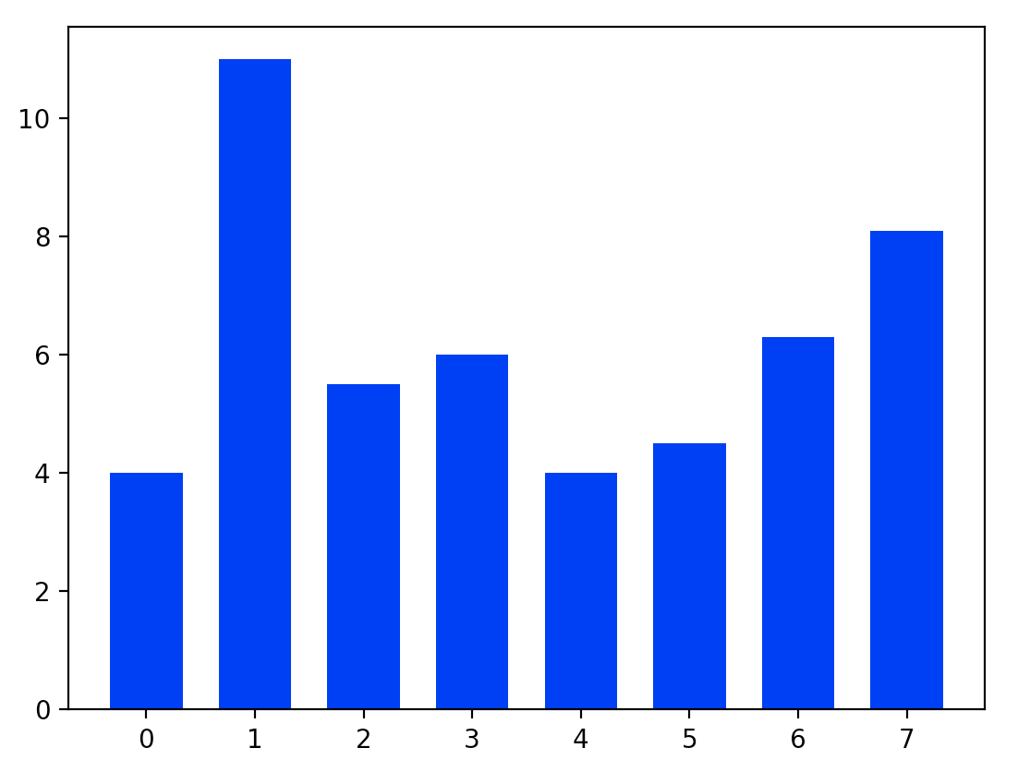
Matplotlib – bar()
Random numbers using scatter():
import matplotlib.pyplot as plt
y = [4, 11, 5.5, 6, 4, 4.5, 6.3, 8.1]
N = len(y)
x = range(N)
width = 1/1.5
plt.bar(x, y, width, color="blue")
plt.show()

Slide 22
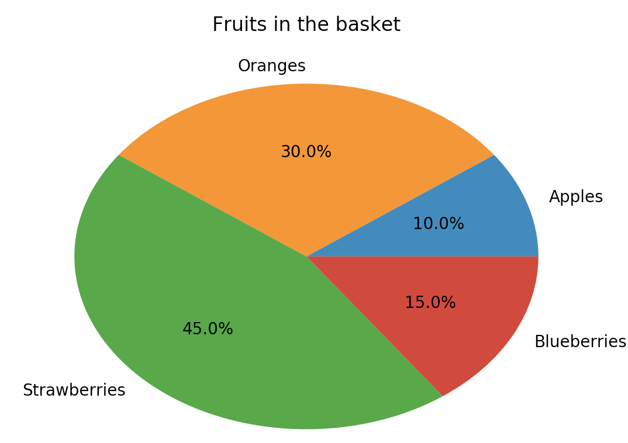
Matplotlib – pie()
Random numbers using scatter():
import matplotlib.pyplot as plt
labels = 'Apples', 'Oranges', 'Strawberries', 'Blueberries'
fracs = [10, 30, 45, 15]
plt.pie(fracs, labels=labels, autopct="%1.1f%%")
plt.title(“Fruits in the basket”) plt.show()

Slide 23
Seaborn
Pandas
Matplotlib
➔ Seaborn
ggplot
Statistical graphs

Slide 24
Seaborn: pretty graphs
Matplotlib graphs are powerful but not very beautiful.
Seaborn makes some pretty plots
Based on Matplotlib
Allows a number of aesthetic parametres.

Slide 25
Seaborn pretty plots
“matplotlib” graphs are powerful but not very beautiful
“seaborn” makes some pretty plots
It is based on “matplotlib”
It allows a number of aesthetic parameters
“seaborn” website - https://seaborn.pydata.org/
“seaborn” needs to be imported
>>> import seaborn as sns

Slide 26
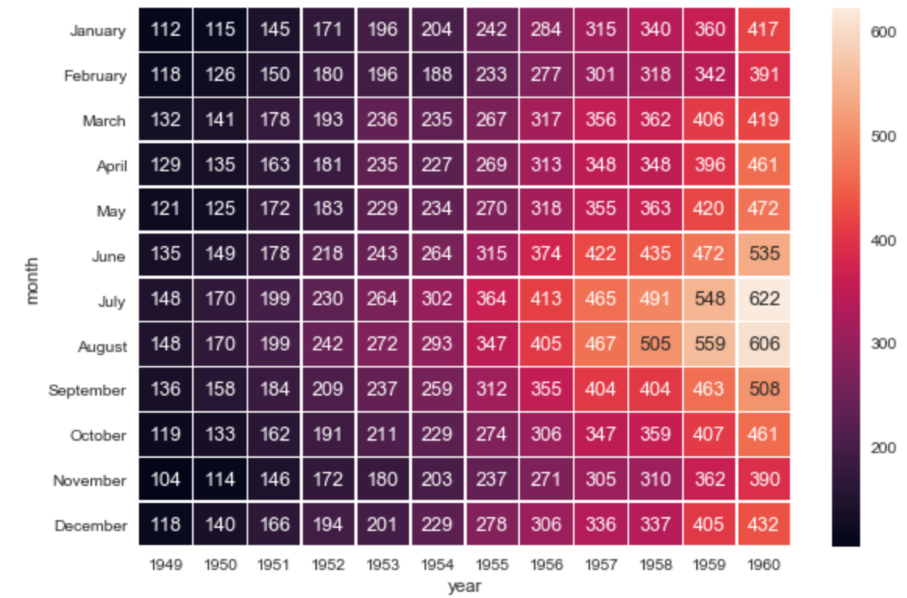
Seaborn Heatmap
import matplotlib.pyplot as plt
import seaborn as sns
sns.set()
f, ax = plt.subplots(figsize=(9, 6))
sns.heatmap(flights, annot=True, fmt="d", linewidths=.5, ax=ax)

Slide 27
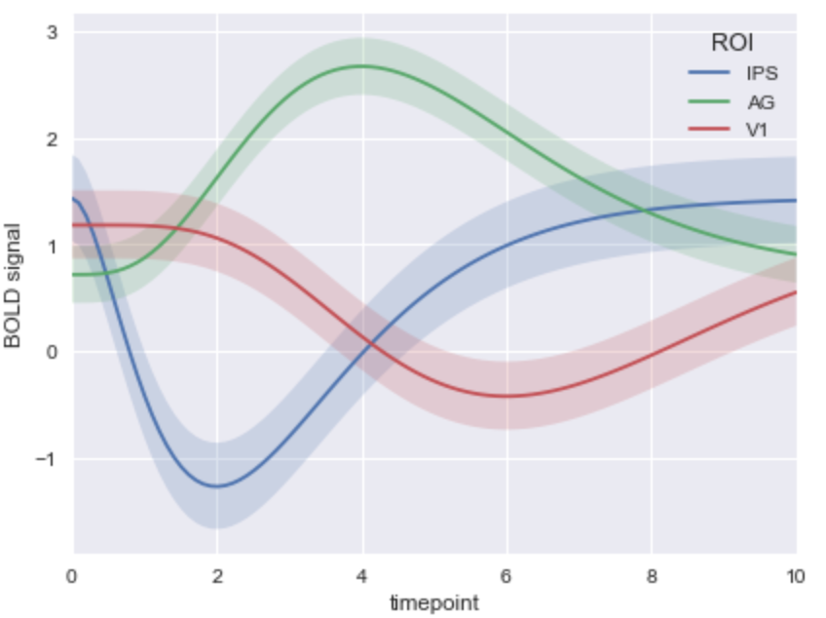
Seaborn time series plot
# Plot the response with standard error
sns.tsplot(data=gammas, time="timepoint", unit="subject”
condition="ROI", value="BOLD signal")

Slide 28
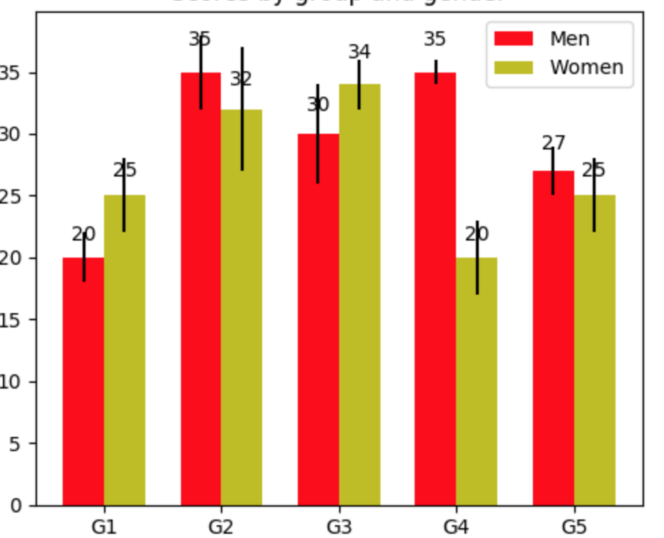
Seaborn – barplot() - Ease of use
Bar plot example – comparison of matplotlib / seaborn code
Lengthier code in matplotlib
fig, ax = plt.subplots()
rects1 = ax.bar(ind, men_means, width, color='r’,yerr=men_std)
rects2 = ax.bar(ind + width, women_means, width, color='y’, yerr=women_std)
ax.set_xticks(ind + width / 2)
ax.legend((rects1[0], rects2[0]), ('Men', 'Women'))

Slide 29
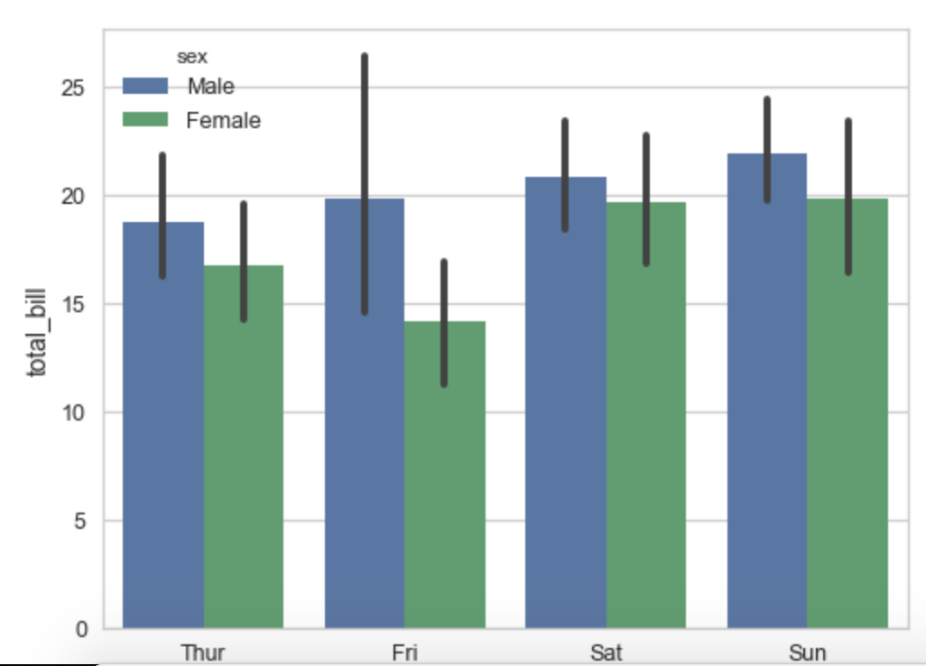
Seaborn – barplot() - Ease of use
Bar plot example – comparison of matplotlib / seaborn code
Condensed shorter code in seaborn for the same plot
ax = sns.barplot(x="day", y="total_bill", hue="sex", data=tips)

Slide 30
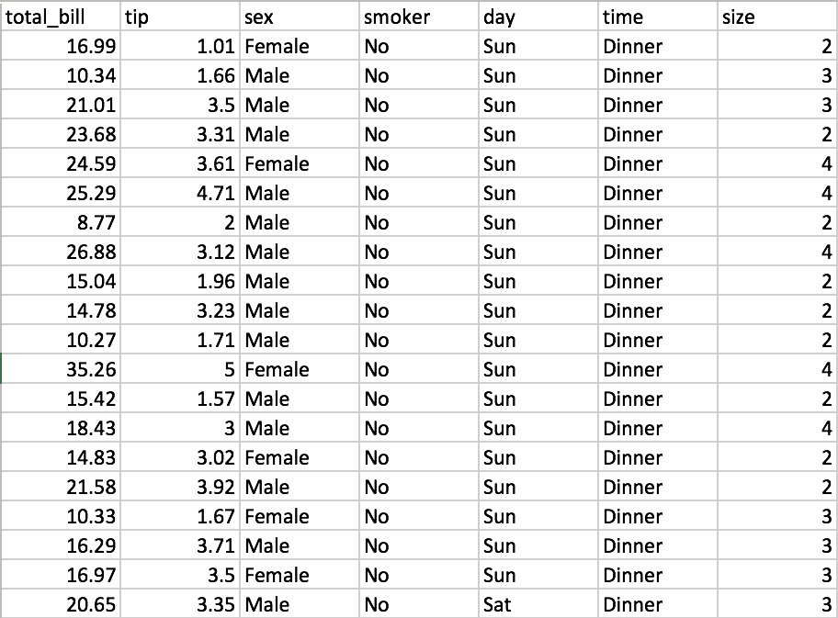
Seaborn – regplot()
Regression plot example
Take a look at the tips.csv dataset (used in example below)

Slide 31
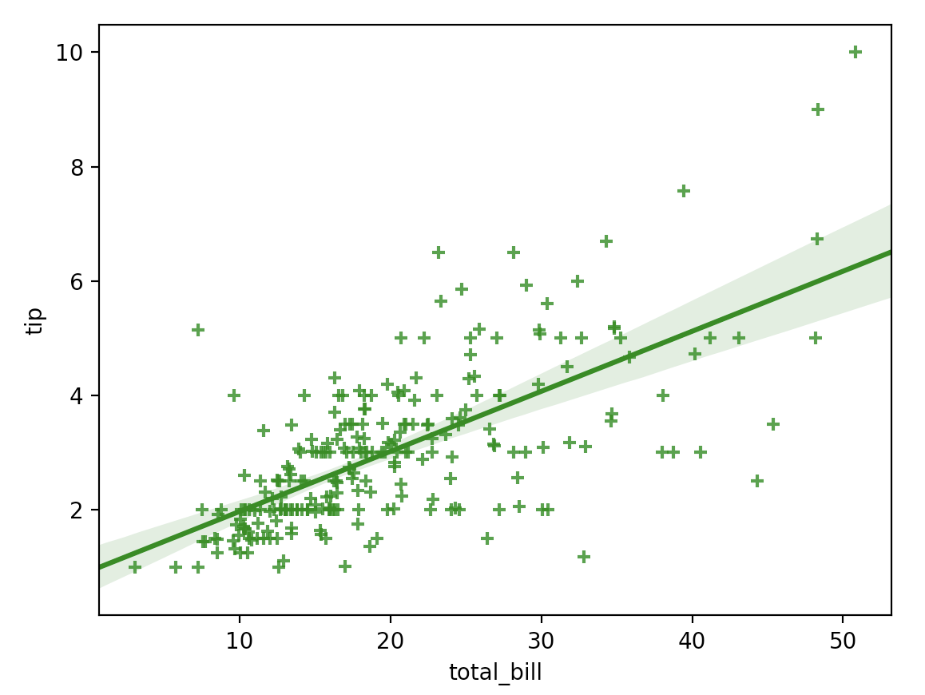
Seaborn – regplot()
Regression plot example
import numpy as np
import matplotlib.pyplot as plt
import seaborn as sns
import pandas as pd tips = sns.load_dataset("tips") sns.regplot(x="total_bill", y="tip", data = tips, color="g", marker="+")
plt.show()

Slide 32
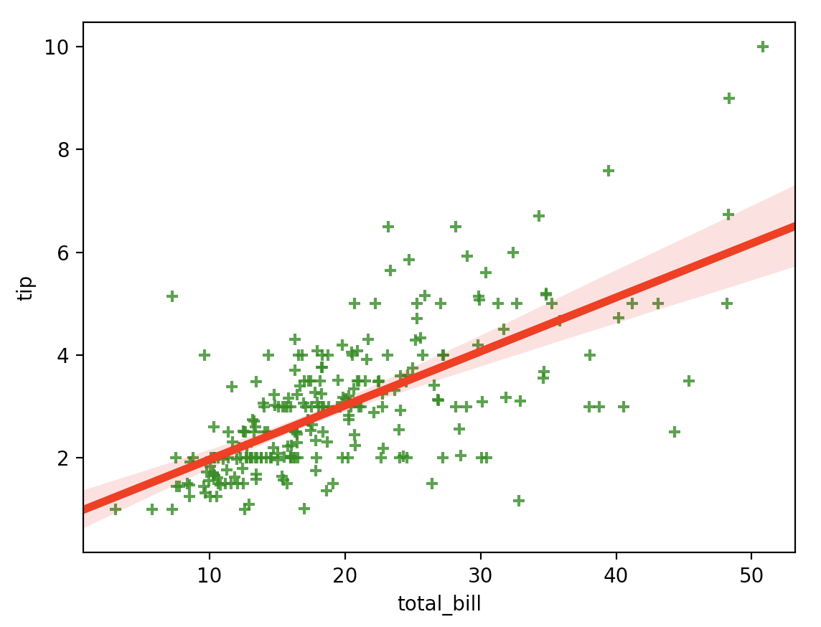
Seaborn – regplot()
Regression plot example
import numpy as np
import matplotlib.pyplot as plt
import seaborn as sns
import pandas as pd tips = sns.load_dataset("tips") sns.regplot(x = "total_bill", y = "tip", data = tips, marker = "+", scatter_kws = {"color" : "green"}, line_kws = {"color" : "red", "linewidth" : 4}) plt.show()

Slide 33
Seaborn Heatmap
import matplotlib.pyplot as plt
import seaborn as sns
sns.set()
f, ax = plt.subplots(figsize=(9, 6))
sns.heatmap(flights, annot=True, fmt="d", linewidths=.5, ax=ax)

Slide 34
Seaborn time series plot
# Plot the response with standard error
sns.tsplot(data=gammas, time="timepoint", unit="subject”
condition="ROI", value="BOLD signal")

Slide 35
ggplot
Pandas
Matplotlib
Seaborn
Ggplot
Statistical graphs

Slide 36
ggplot
ggplot package is a very popular graphics package
Based on ggplot2 package in R
Provides very readable graphics
Has a ‘grammar’ to describe graph
Excels at graphing complex data sets
Mastering ggplot can be ‘challenging’ ☺
Recommended book : “ggplot2: Elegant Graphics for Data Analysis”
http://www.ling.upenn.edu/~joseff/rstudy/summer2010_ggplot2_intro.html

Slide 37
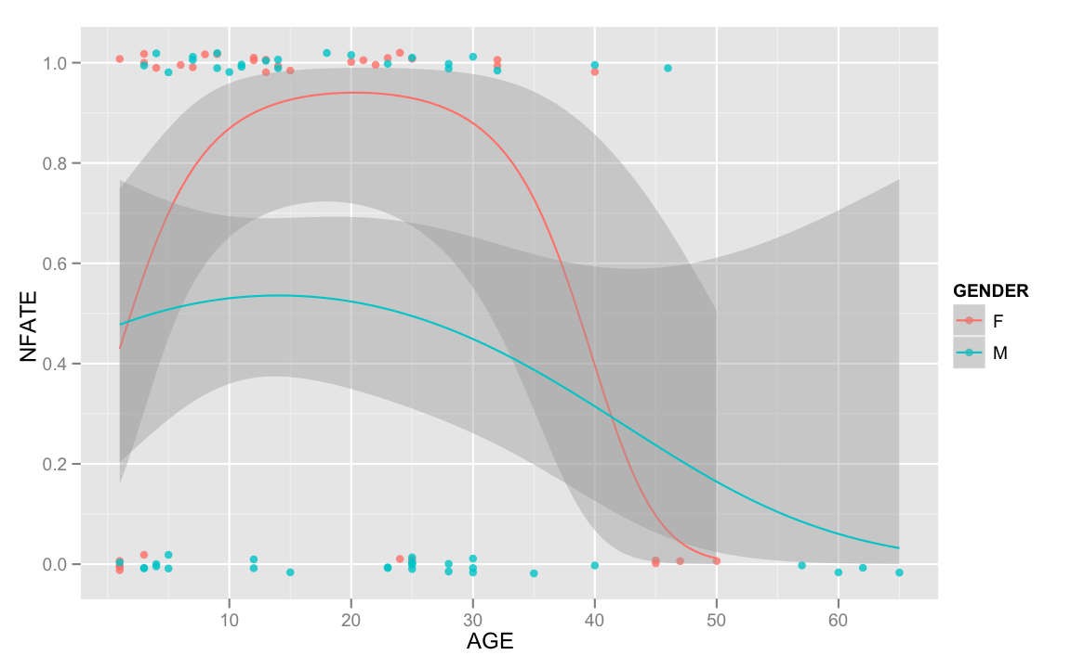
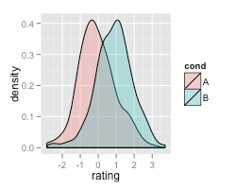
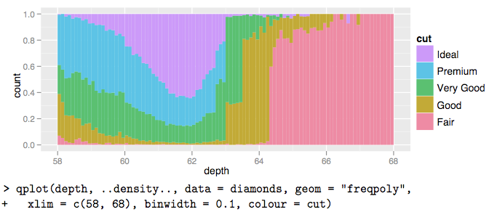
ggplot examples

Slide 38
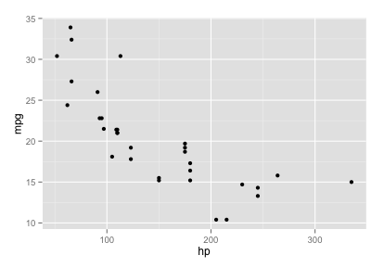
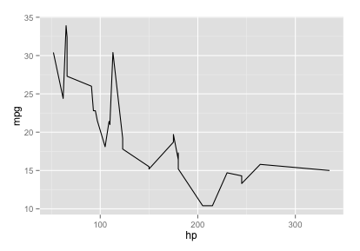
ggplot Quick Example
import ggplot ggplot(mtcars, aes(hp, mpg)) # Error: No layers in plot
# add a layer ggplot(mtcars, aes(hp, mpg)) + geom_point() # try a different layer ☺ ggplot(mtcars, aes(hp, mpg)) + geom_line()

Slide 39
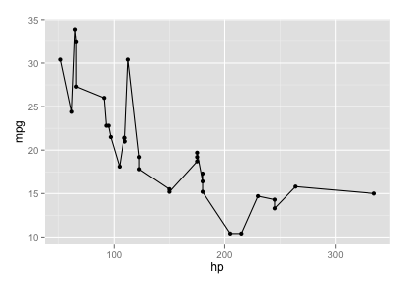
ggplot Quick Example: Layers
g = ggplot(mtcars, aes(hp, mpg)) g # Error: no layers
# add a layer g = g + geom_point() g # wow!
# add another layer g = g + geom_line() g # ☺

Slide 40
ggplot Syntax
ggplot (data, aesthetics, layers)
Data: data frame, vector, etc.
Aesthetics (aes)
Maps how elements get converted to graph
X position / x-y position / shape / color
Layers
Geometric shapes
Points / lines / bars

Slide 41
Ggplot – general syntax
Syntax
Involves Data, Aesthetics and Layers
ggplot (data, aes, layers)
data
can be DataFrame, vector, etc.
aes
Maps how elements get converted to graph
x position / x-y position / shape / color
layers
Geometric shapes
Points / lines / bars

Slide 42
Ggplot point and line plots
Quick example of point and line plots:
import ggplot ggplot(mtcars, aes(hp, mpg)) #Error: No layers in plot ggplot(mtcars, aes(hp, mpg)) + geom_point() #point layer ggplot(mtcars, aes(hp, mpg)) + geom_line() #line layer

Slide 43
Ggplot point and line plots
Same example of point and line plots (w/ variable assignment)
import ggplot g = ggplot(mtcars, aes(hp, mpg)) #Error: No layers in plot g1 = g + geom_point() #point layer g2 = g + geom_line() #line layer

Slide 44
Lab: Graphs / ggplot-qplot
Lab
Overview: Exploring graphing with Python
Approximate time: 30 minutes
Instructions :
9.3-ggplot1.md (qplot)
9.4-ggplot2.md (ggplot)

Slide 45
Statistical Graphs
Pandas
Matplotlib
Seaborn
Ggplot
Examples
Statistical Graphs

Slide 46
Visualizing Data
Method | Description
Boxplot | A quick way to visualize the data
Frequency table | Count number of data points that fall into intervals (bins)
histogram | Plot of frequency table
Density plot | Smoothed version of histogram. (Kernel Density Estimate)

Slide 47
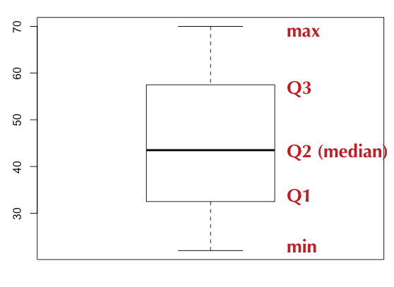
Boxplot / Box-and-Whisker Plot
Boxplot displays 5 measures : min, Q1, Q2 (median), Q3, max
Smallest / Largest values are measured within upper/lower fences
Fences are 1.5 times IQR
Income data (sorted): [22k, 25k, 30k, 35k, 40k, 42k, 45k, 50k, 55k, 60k, 65k, 70k]

Slide 48
Boxplot / Box-and-Whisker Plot
Boxplot displays 5 measures : min, Q1, Q2 (median), Q3, max
Q1, Q2, Q3 are the first, second and third quartiles
Smallest / Largest values are measured within upper/lower fences
Fences are usually 1.5 times IQR (Q3 – Q1)

Slide 49
BoxPlot : Sample Code (R)
income = c(22, 25, 30, 35, 40, 42, 45, 50, 55, 60, 65, 70)
bp = boxplot(income)
bp
$stats
[,1]
[1,] 22.0
[2,] 32.5
[3,] 43.5
[4,] 57.5
[5,] 70.0
$n
12

Slide 50
BoxPlot : Sample Code (Python)
%matplotlib inline import numpy as np import matplotlib.pyplot as plt salaries = np.array([22, 25, 30, 35, 40, 42, 45, 50, 55, 60, 65, 70]) plt.boxplot(salaries)

Slide 51
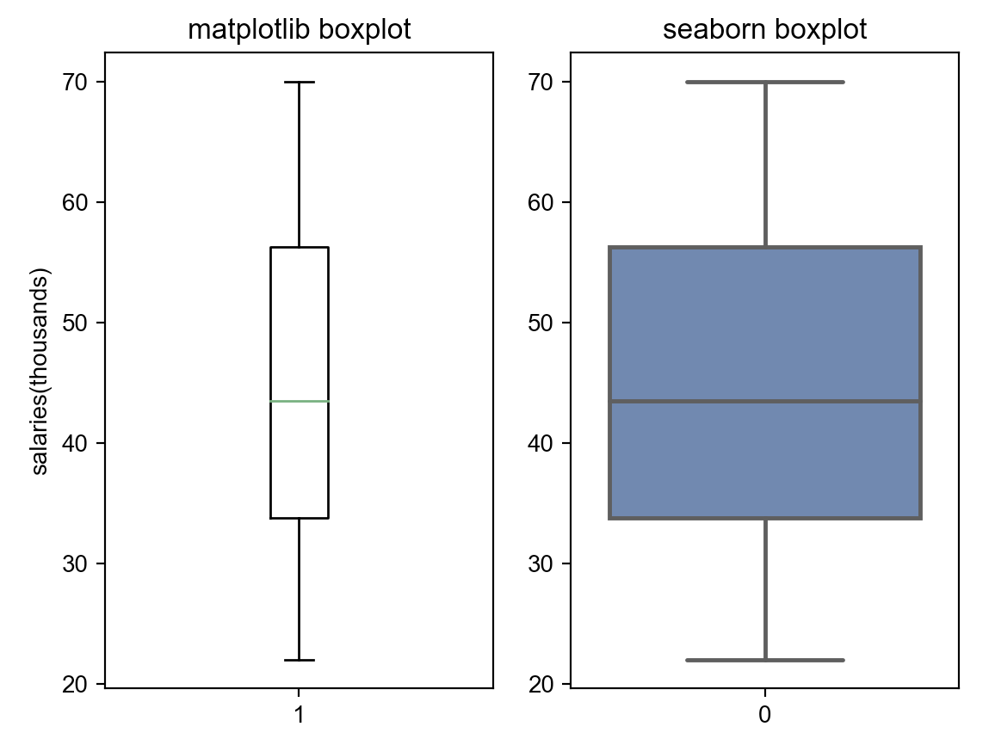
Boxplot / Box-and-Whisker Plot
Example: Boxplot for income data (sorted)
[22k, 25k, 30k, 35k, 40k, 42k, 45k, 50k, 55k, 60k, 65k, 70k]
import numpy as np
import matplotlib.pyplot as plt
import seaborn as sns
salaries = np.array([22, 25, 30, 35, 40, 42, 45, 50, 55, 60, 65, 70])
plt.figure()
plt.title("Boxplots")
plt.subplot(1, 2, 1)
m = plt.boxplot(salaries)
plt.ylabel("salaries(thousands)")
plt.title("matplotlib boxplot")
plt.subplot(1, 2, 2)
sns.set()
s = sns.boxplot(data = salaries)
plt.title("seaborn boxplot")
plt.show()

Slide 52
Histogram (R)
Histogram counts data points per bin
income = c(22, 25, 30, 35, 40, 42, 45, 50, 55, 60, 65, 70)
hist(income)

Slide 53
Histogram (Python)
Histogram counts data points per bin
%matplotlib inline import pandas as pd import numpy as np import matplotlib.pyplot as plt salaries = np.array([22, 25, 30, 35, 40, 42, 45, 50, 55, 60, 65, 70]) plt.hist(salaries, rwidth=0.7)

Slide 54
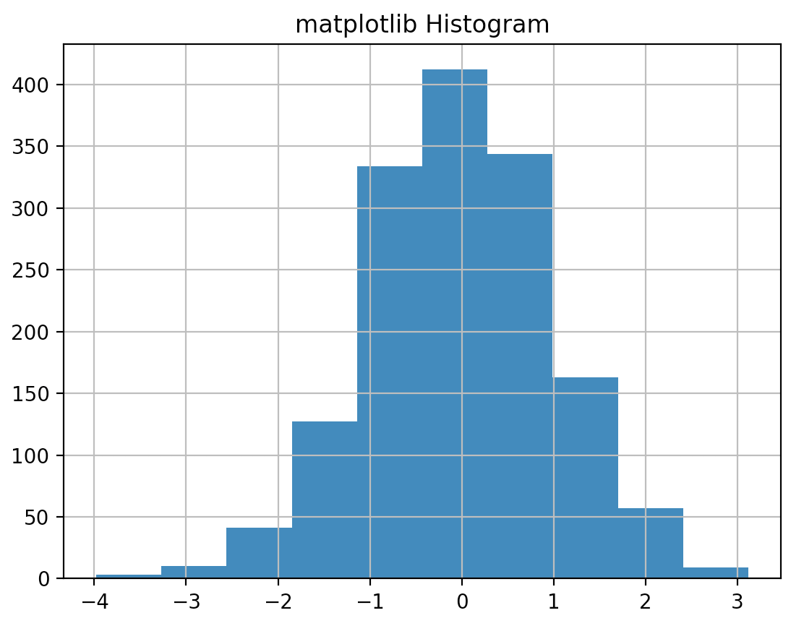
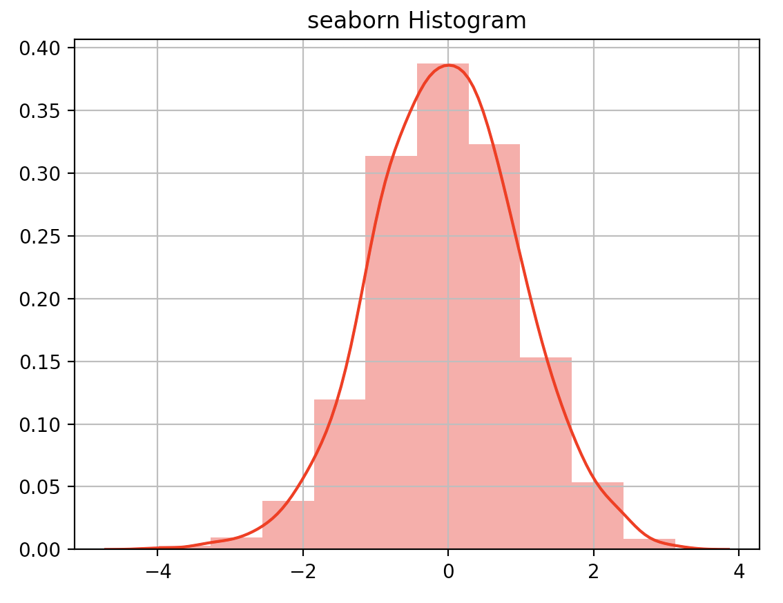
Histograms
Example: Histogram for np.random.randn() data
import numpy as np
import matplotlib.pyplot as plt
import seaborn as sns
num = np.random.randn(1500)
plt.figure()
# plt.title("Histograms")
# plt.subplot(2, 1, 1)
m = plt.hist(num, bins=10)
plt.grid(True)
plt.title("matplotlib Histogram")
plt.figure()
# plt.subplot(2, 1, 2)
s = sns.distplot(num, color = "r", bins = 10)
plt.grid(True)
plt.title("seaborn Histogram")
plt.show()

Slide 55
Scatter Plot (Python)
Histogram counts data points per bin
%matplotlib inline import numpy as np import matplotlib.pyplot as plt bills = np.array([50,30,60,40,65,20,10,15,25,35]) tips= np.array([12,7,13,8,15,5,2,2,3,4]) plt.xlabel("bill amount") plt.ylabel("tip") plt.scatter(bills, tips)

Slide 56
Examples
Pandas
Matplotlib
Seaborn
Ggplot
Statistical graphs
Examples

Slide 57
Bar Plots: Matplotlib
Example of a barplot
fig, ax = plt.subplots()
rects1 = ax.bar(ind, men_means, width, color='r’,yerr=men_std)
rects2 = ax.bar(ind + width, women_means, width, color='y’, yerr=women_std)
# add some text for labels, title and axes ticks
ax.set_xticks(ind + width / 2)
ax.legend((rects1[0], rects2[0]), ('Men', 'Women'))

Slide 58
Barplot: Seaborn
Seaborn is easier!
ax = sns.barplot(x="day", y="total_bill", hue="sex", data=tips)

Slide 59
Lab: matplotlib - intro
Lab
Overview: Intro to matplotlib
Approximate time: 10 mins
Instructions:
06__pythonVisualization | 6.1-matplotlibIntro.ipynb

Slide 60
Lab: matplotlib - cars
Lab
Overview: Learn matplotlib and seaborn by exploration of the cars dataset
Approximate time: 20 mins
Instructions:
06__pythonVisualization | 6.2-matplotlibCars.ipynb

Slide 61

Review

